Slide 1
Graph Regularized Non-negative Matrix Factorization for Data Representation
Authors: D. Cai, X. He, J.Han and Thomas S. Huang,2011
Reporter:Yunfei Wang
Sep.21,2012

Slide 2
Outline
NMF with Manifold Regularization
Updating Rules
Computational Complexity Analysis
Experimental results
Proofs of convergence
Weighted NMF and GNMF

Slide 3
NMF with Manifold Regularization
Local invariance assumption
Two data points close in the intrinsic geometry of the data distribution, the respect to the new basis are also close to each other.
Drawback of NMF
Failing to discover the intrinsic geometrical and discriminating structure of the data space
GNMF
Incorporating a geometrically based regularizer into NMF.

Slide 4
Nearest Neighbor Graph
Model the geometric structure effectively
Weight Matrix
1) 0-1 weighting
2) Heat kernel weighting
3) Dot-product weighting

Slide 5
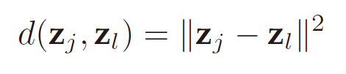
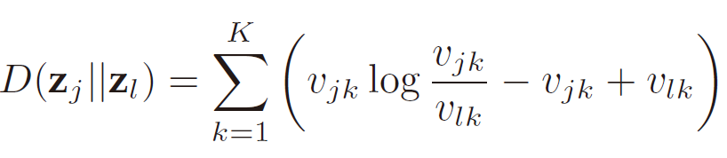
Measure the dissimilarity in NMF
Euclidean distance
Divergence

Slide 6
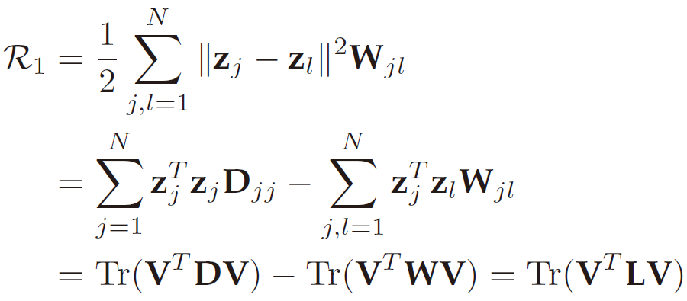
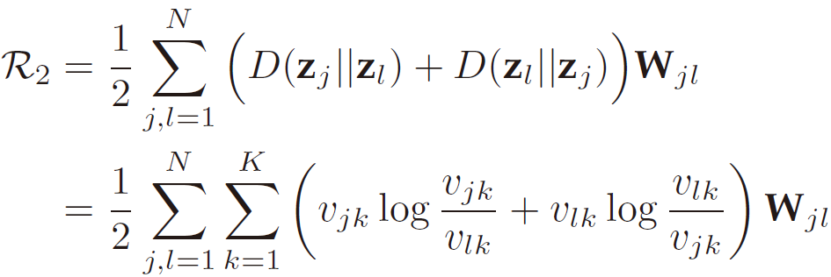
Measure the smoothness
Euclidean distance
Divergence

Slide 7
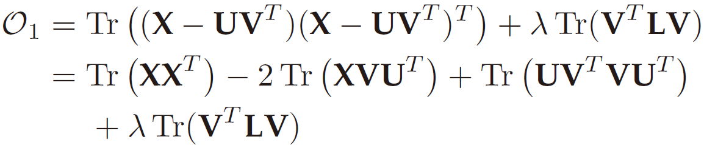
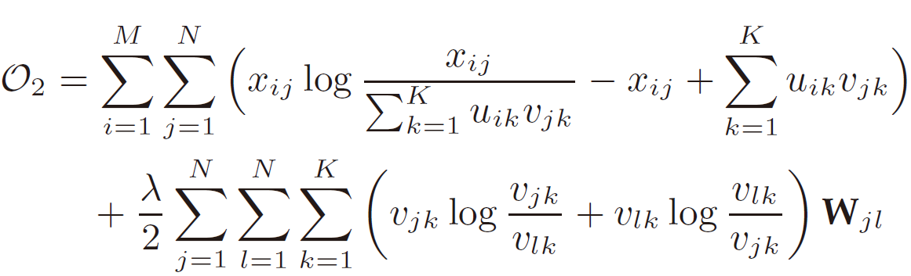
Objective functions in GNMF
Euclidean distance
Divergence

Slide 8
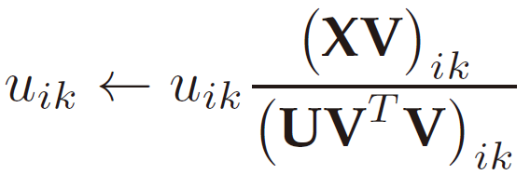
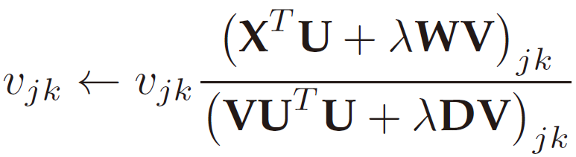
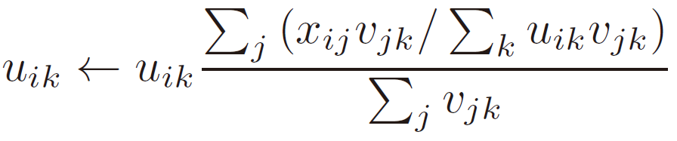
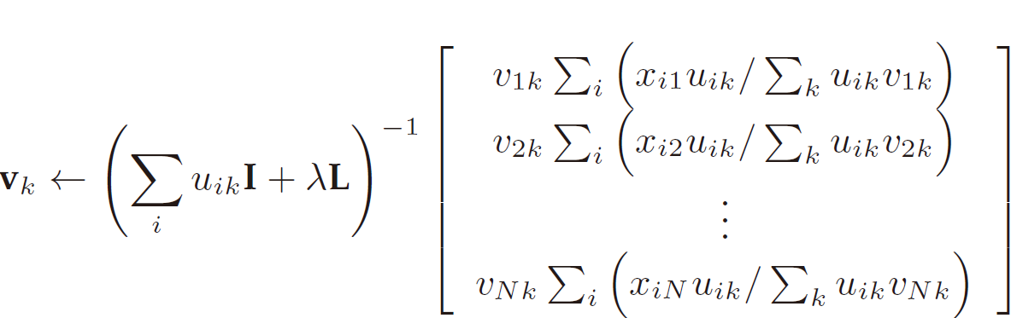
Updating Rules
Euclidean distance
Divergence

Slide 9
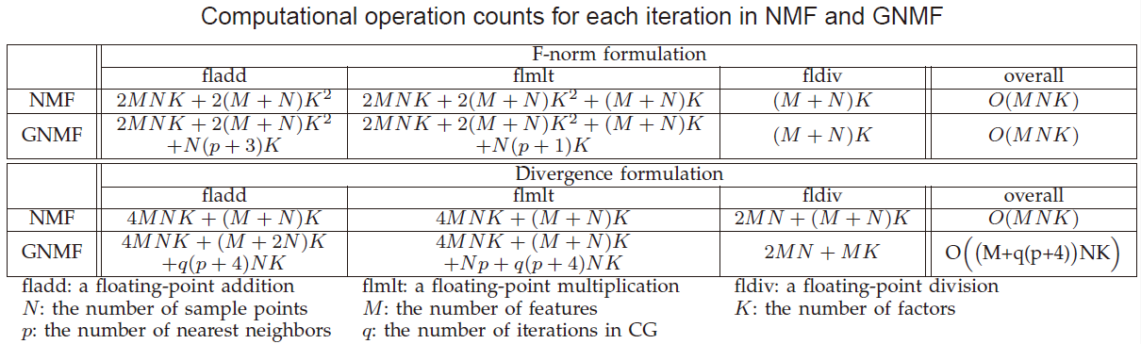
Computational Complexity Analysis

Slide 10
Proofs of convergence
The proving steps are similar to NMF
Define an auxiliary function
Construct an auxiliary function for objective function
Prove the function constructed above satisfy all the conditions.
Get the update rules by setting the gradient of auxiliary function to zero.

Slide 11
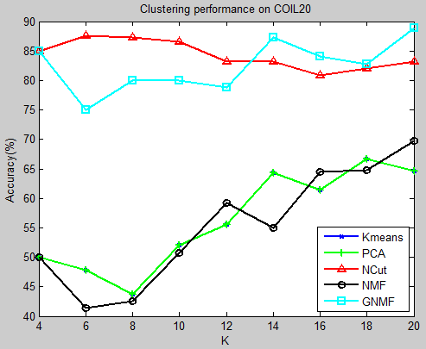
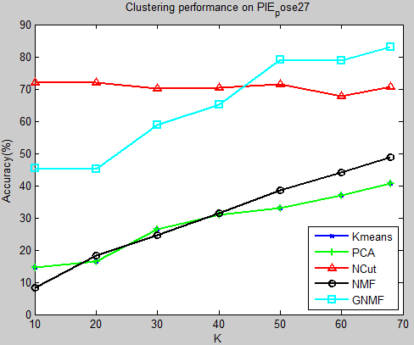
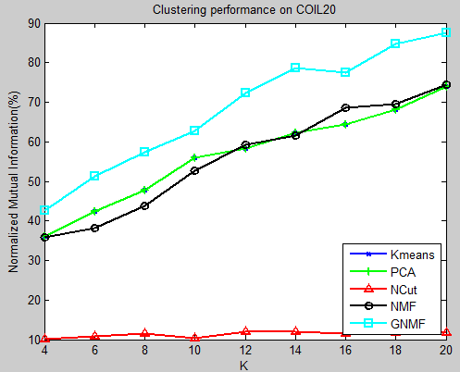
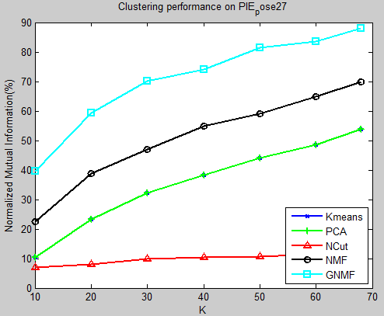
Experimental results

Slide 12
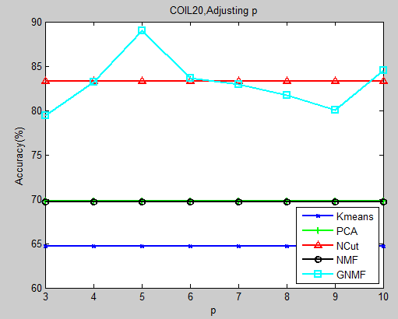
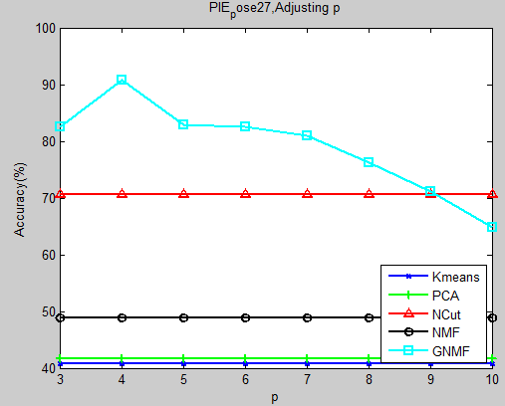
Experimental results

Slide 13
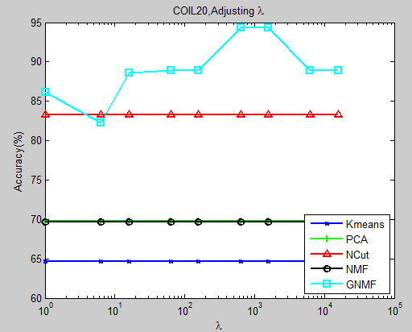
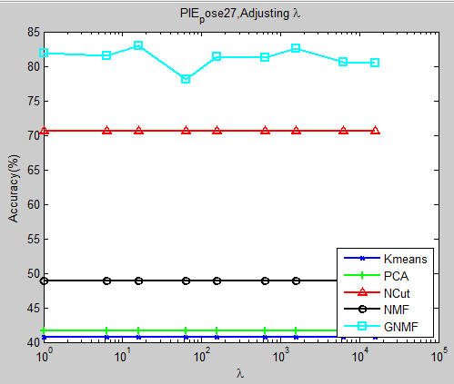
Experimental results

Slide 14
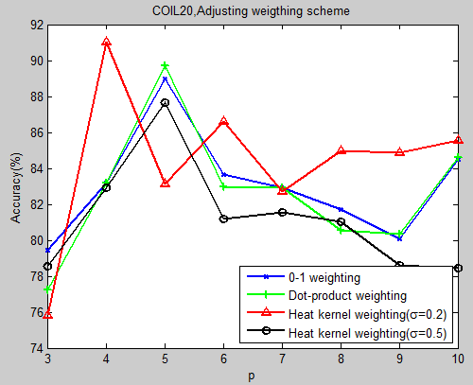
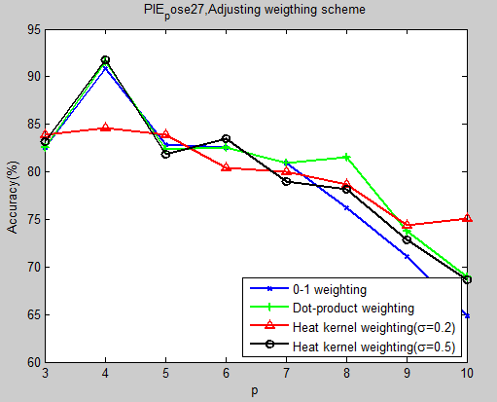
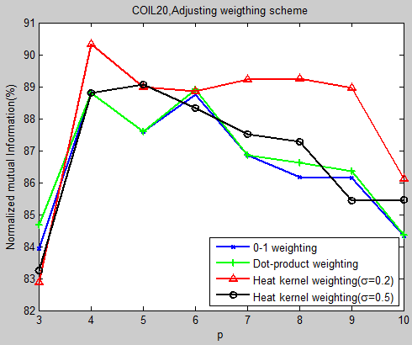
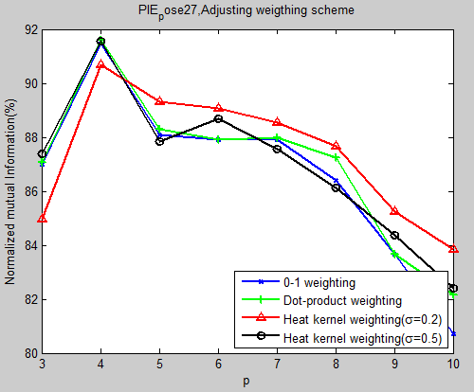
Experimental results

Slide 15
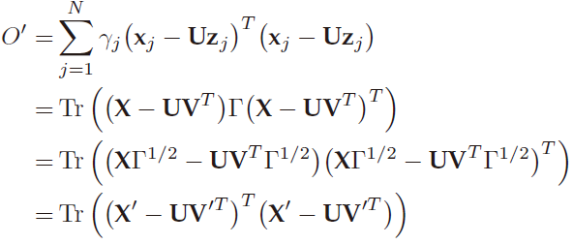
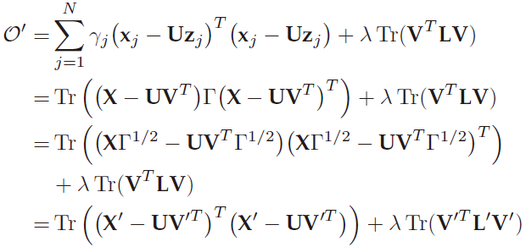
Weighted NMF and GNMF
Weighted NMF
Weighted GNMF

